Slide 1
Painting
LECTURE 2

Slide 2
MAJOR TYPES (genre) OF PAINTING
A landscape is an outdoor scene. A landscape artist uses paint to create not only land, water, and clouds but air, wind, and sunlight.
A portrait is an image of a person or animal. Besides showing what someone looks like, a portrait often captures a mood or personality.
A still life shows objects, such as flowers, food, or musical instruments. A still life reveals an artist's skill in painting shapes, light, and shadow.
A real life scene captures life in action. It could show a busy street, a beach party, a dinner gathering, or anyplace where living goes on.
A religious work of art shares a religious message. It might portray a sacred story or express an artist's faith

Slide 3
Style
Some paintings seem to show exactly what an artist saw, while others focus on exploring shapes or expressing feelings. One artist might paint a landscape with realistic details, such as craggy rocks and green blades of grass. Another might paint the same landscape in swirling shapes and colors that capture how the air and sunlight felt.

Slide 4
Techniques of painting
Mural painting
Easel painting
Miniature painting

Slide 5
Mural painting
A mural is any piece of artwork painted or applied directly on a wall, ceiling or other large permanent surface. A distinguishing characteristic of mural painting is that the architectural elements of the given space are harmoniously incorporated into the picture.
Some wall paintings are painted on large canvases, which are then attached to the wall (e.g., with marouflage). Whether these works can be accurately called "murals" is a subject of some controversy in the art world, but the technique has been in common use since the late 19th century.^{[1]}

Slide 6
A Mural painting could be…
Painted
Mosaic
Fiber glass
Glass
Photograph
Ceramic/clay etc……
A Mural is an art work which is directly done on wall or made for the wall

Slide 7
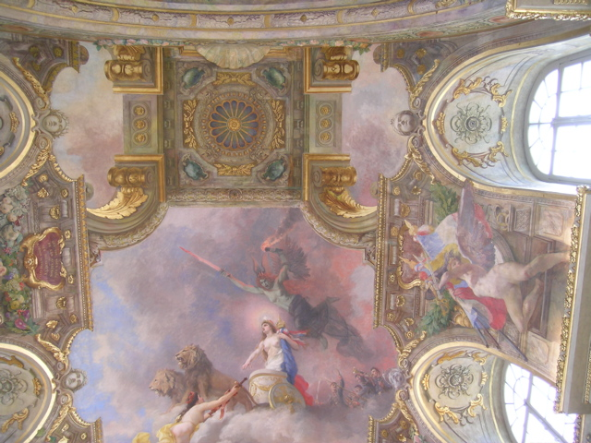

Slide 8
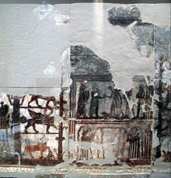
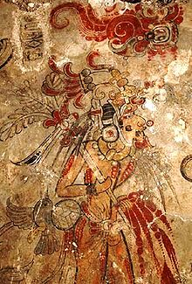

Slide 9
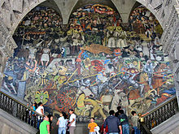
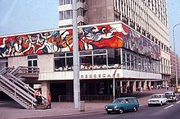

Slide 10
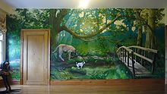
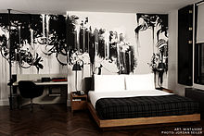

Slide 11
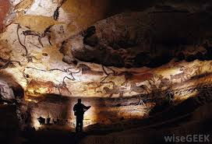
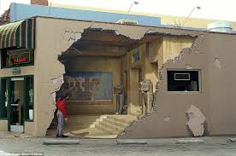

Slide 12
Illusionistic Mural painting

Slide 14
Easel painting
Easel painting is a term in art history for the type of mid-size painting that would have been painted on an easel, as opposed to a fresco wall-painting or miniature that would have been created sitting at a desk, though perhaps also on an angled support. It does not refer to the method of display after creation; in fact most easel paintings are intended to be displayed framed and hanging on a wall

Slide 15
History of easel painting
Easels are known to have been in use since the time of the ancient Egyptians. In the 1st century, Pliny the Elder makes reference to a large panel placed upon an easel.

Slide 16
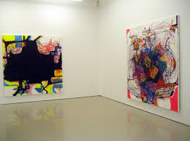
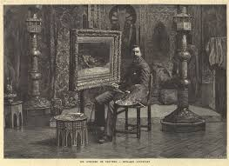

Slide 17
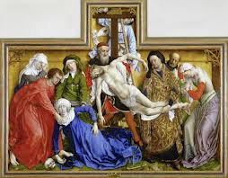
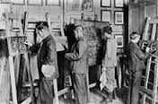

Slide 18
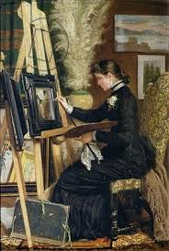
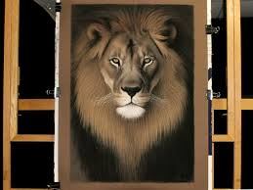

Slide 19
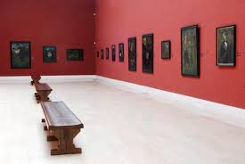
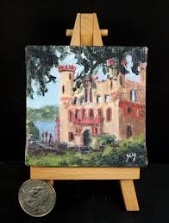

Slide 20
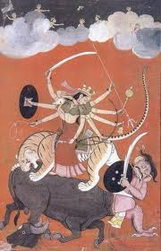
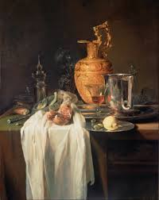

Slide 21
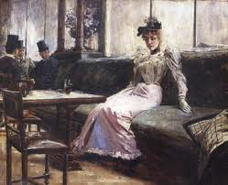
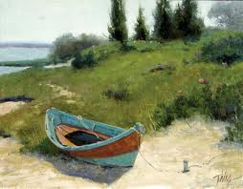

Slide 22
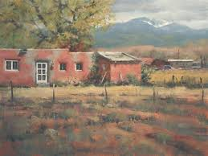
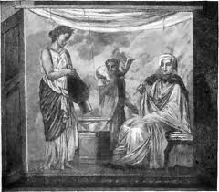

Slide 23
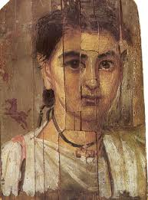
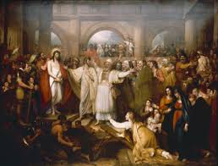

Slide 24
Miniature (illuminated manuscript)
The word miniature, derived from the Latin minium, red lead, is a picture in an ancient or medieval illuminated manuscript; the simple decoration of the early codices having been mini-ated or delineated with that pigment. The generally small scale of the medieval pictures has led secondly to an etymological confusion of the term with minuteness and to its application to small paintings especially portrait miniatures, which did however grow from the same tradition and at least initially use similar techniques.

Slide 25
Apart from the Western and Byzantine traditions, there is another group of Asian traditions, which is generally more illustrative in nature, and from origins in manuscript book decoration also developed into single-sheet small paintings to be kept in albums, which are also called miniatures, as the Western equivalents in watercolor and other mediums are not. These include Persian miniatures, and their Mughal, Ottoman and other Indian offshoots.

Slide 26
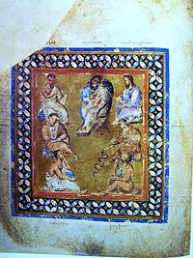
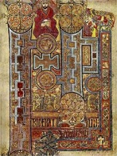

Slide 27
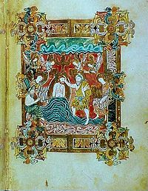
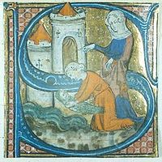

Slide 28
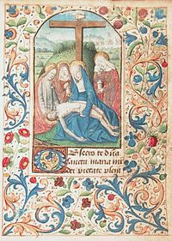
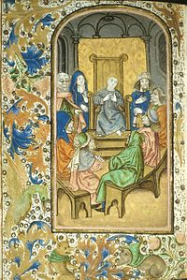

Slide 29
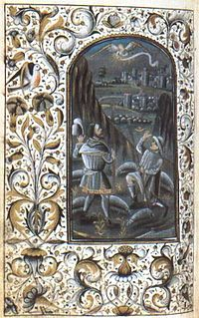

Slide 30
Persia (Iran)
Safavid era Miniature painting kept at Shah Abbas Hotel in Isfahan.
Yusuf and Zulaikha (Joseph chased by Potiphar's wife), miniature by Behzād, 1488.
Main article: Persian miniature
Persian art has a long tradition of the use of miniatures.
Reza Abbasi (1565–1635), considered one of the most renowned Persian painters of all time, specialized in the Persian miniature, with a preference for naturalistic subjects. Today his surviving works can be found in many of the major museums of the Western world, such as the Smithsonian, the Louvre and the Metropolitan Museum of Art.

Slide 31
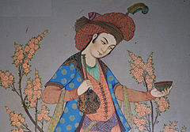

Slide 32
Mughal miniatures
Main article: Mughal painting
The Emperor Jahangir receiving his two sons, an album-painting of c 1605-06
Mughal painting, generally confined to miniatures either as book illustrations or as single works to be kept in albums, emerged from the Persian miniature painting tradition, with Indian influences, and developed during the period of the Mughal Empire (16th -19th centuries). Mughal miniatures are very detailed and very fine in quality. Padshanama is important book of the Mughal miniature Painting

Slide 34
Ottoman empire
Portrait of a painter during the reign of Mehmet II
Main article: Ottoman miniature

Slide 35
Ottoman empire

Slide 36
Forgeries
Medieval miniatures have been forged to deceive collectors by various persons most notably including the Spanish Forger.

Slide 37
Sub-Techniques of mural painting
Fresco (boun)
Fresco (secco)
Mosaics
Stained glass
Tempera
Mix media

Slide 38
Fresco (buon)
Buon fresco (Italian for true fresco) is a fresco painting technique in which alkaline resistant pigments, ground in water, are applied to plaster when it is still wet, as opposed to fresco-secco (or a secco). The buon fresco technique consists of painting with pigment ground in water on a thin layer of wet, fresh, lime mortar or plaster, for which the Italian word for plaster, intonaco, is used. Because of the chemical makeup of the plaster, a binder is not required. After a number of hours the plaster reacts with the air in a process called carbonatation: this chemical reaction fixes the pigment particles at the plaster's surface in a protective crystalline mesh^{[1]} known as the lime crust. One of the first painters in the post-classical period to use this technique was the Isaac Master in the Upper Basilica of Saint Francis in Assisi

Slide 39
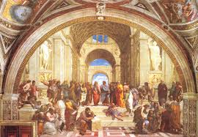

Slide 40
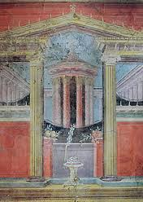
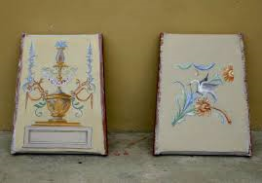

Slide 41
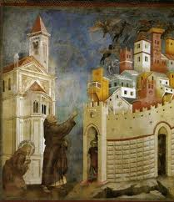
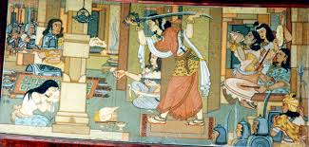

Slide 42
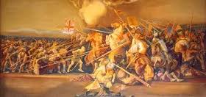
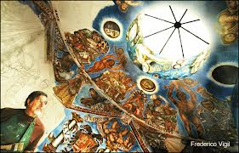

Slide 43
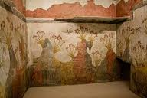
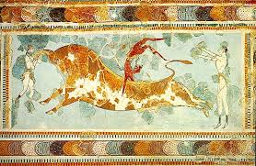

Slide 44
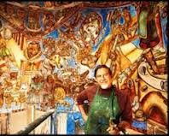
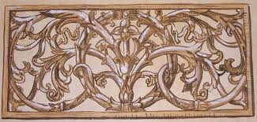

Slide 45
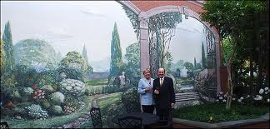

Slide 46
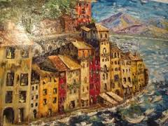
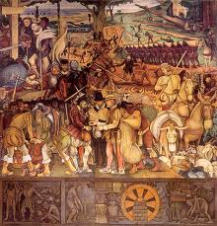

Slide 47
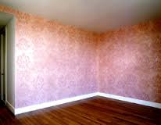
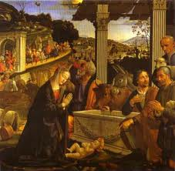

Slide 48
